Slide 1
Bash Scripting: control structures
CISC3130
Spring 2013
Fordham Univ.

Slide 2
Roadmap
Shell variables
Shell Arithmetic
Control Structures
Test, condition, logic operations
Selection: if statements
Loop: while, until, for loops; break, continue
case construct

Slide 3
Bash special characters
Globbing: filename expansion
E.g., ls *.cpp, rm *.o, etc.
Shell expands filename patterns or templates containing special characters
Can be turned off: set –f, shopt
Shell special characters
*, ?, [,], |, >, <, >>
Quotations: single quote, double quote, back quote

Slide 4
SHELL Variables
Different types of variables
Environment variables: HOME, PATH, PS1, PS2 …
Parameter variables: $1, $*, …
User defined variables: student, file, x, ..
Recall we set PATH variable in lab1 …
PATH=$PATH:.:~zhang/bin
export PATH # make PATH an environment variable, which is inherited by all subprocesses
Example:
[zhang@storm ~]$ x=1
[zhang@storm ~]$ export x
[zhang@storm ~]$ bash
[zhang@storm ~]$ echo $x
1

Slide 5
Shell parameter variables
If your script is invoked with parameters, shell sets parameter variables
$#: number of parameters
$0, $1, …: command/script name, first/second parameters
$*, $@: Represents all command-line arguments at once. They can be used to pass command-line arguments to a program being run by a script or function.

Slide 6
Shell parameter variables (2)
"$*": all command-line arguments as a single string. Equivalent to "$1$2 …". The first character of $IFS is used as separator for different values,
printf "The arguments were %s\n" "$*"
"$@": all command-line arguments as separate, individual strings. Equivalent to "$1" "$2" …. best way to pass arguments on to another program, since it preserves any whitespace embedded within each argument.
lpr "$@" Print each

Slide 7
Set command
set command, a shell builtin command
display current variables, “set”
set shell options, “set –f”, “set –n” ..
set position parameters (no options),
[zhang@storm ~]$ set Hello world; echo $1, $2
Hello world
Combine command substitution and set command
[zhang@storm ~]$ set `who am i`
[zhang@storm ~]$ echo Welcome, $1! You logged in from $5.
[zhang@storm ~]$ set `date`
[zhang@storm ~]$ echo The year is $6
The year is 2013

Slide 8
$ set -- hello "hi there" greetings Set new positional parameters
$ echo there are $# total arguments ##Print the count
there are 3 total arguments
$ for i in $* #Loop over arguments individually
> do echo i is $i
> done
i is hello Note that embedded whitespace was lost
i is hi
i is there
i is greetings

Slide 9
$ set -- hello "hi there" greetings Set new positional parameters
$ for i in $@ # Without quotes, $* and $@ are the same
> do echo i is $i
> done
i is hello
i is hi
i is there
i is greetings
$ for i in "$*" # With quotes, $* is one string
> do echo i is $i
> done
i is hello hi there greetings

Slide 10
$ for i in "$@" With quotes, $@ preserves exact argument values
> do echo i is $i
> done
i is hello
i is hi there
i is greetings
$

Slide 11
User defined variables
Declare variables by using them, e.g.,
[zhang@storm ~]$ for letter in a b c
> do
> echo "Letter $letter"
> done
Letter a
Letter b
Letter c

Slide 12
Read variable value from input
[zhang@storm ~]$ read timeofday
Morning
[zhang@storm ~]$ echo Good $timeofday!
Good Morning!
[zhang@storm ~]$ read greeting
Good morning # don’t need to quote
[zhang@storm ~]$ echo $greeting
[zhang@storm ~]$ Good morning
[zhang@storm ~]$ echo “$greeting” is \$greeting.
What will be the output ?

Slide 13
Command Substitution
Command substitution: substitute output of a command (a string) into another context, i.e., command
Syntax: enclose command using backquote, or $()
As argument for another command
rm `ls *.o` ## same as rm *.o
To set a variable
time1=$(date); echo $times1 ## set the output of date to variable times
To be used in “for” construct
for file in `ls *`; do ## for every file in current directory, do something
…
done

Slide 14
Variable’s default type: string
Variables values are stored as strings
[zhang@storm ~]$ number=7+5
[zhang@storm ~]$ echo $number
7+5
[zhang@storm ~]$ x=2; y=3
[zhang@storm ~]$ z1=x+y; z2=$x+$y
[zhang@storm ~]$ echo $z1 $z2 # What will be the output?

Slide 15
Arithmetic Evaluation
arithmetic expression:
[zhang@storm ~]$ x=1
[zhang@storm ~]$ x=$[$x+1] ## x now has value of 2
[zhang@storm ~]$ y=$((2*$x+16)) ## y now has value of 20
Note: spaces around operators optional
Complex expressions supported
No spaces around equals sign, as with any bash variable assignment

Slide 16
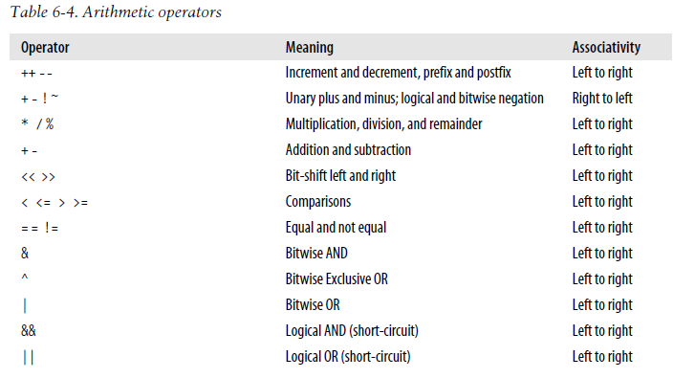
From highest precedence to lowest
Relational operators (<, <=, …) produces a numeric result that acts as a truth value

Slide 17
Arithmetic Evaluation (2)
Or use command expr (less efficient)
[zhang@storm ~]$ x=`expr $x + 1` # increment x by 1
[zhang@storm ~]$ x=$(expr $x * 2 )
Recall:
two diff. syntaxes for command substitution
spaces before and after operators, why?
No spaces around equals sign, as with any bash variable assignment
E.g., convert 38 F to Celsius degree
expr \( 38 - 32 \) \* 5 / 9 ## need to escape *, (, )
echo $(((38-32)*5/9))

Slide 18
Declare variable
One can explicitly declare a variable:
declare OPTION(s) VARIABLE=value
Option
-a: variable is an array
-f : use function names only
-i: variable is to be treated as an integer; arithmetic evaluation is performed when variable is assigned a value
-l: when assigned a value, all upper-case characters are converted to lower-case.
-r Make names readonly. These names cannot then be assigned values by subsequent assignment statements or unset.
…

Slide 19
Example of numerical variable
[zhang@storm ~]$ declare -i x
[zhang@storm ~]$ x=10
[zhang@storm ~]$ x=x+1
[zhang@storm ~]$ echo $x
11
[zhang@storm ~]$ read x
30
[zhang@storm ~]$ x=x*2
[zhang@storm ~]$ echo $x
60
[zhang@storm ~]$

Slide 20
A bash based calculator
First, let’s implement addition
echo ″calculate x+y″
echo –n ″x=″ ## -n option asks echo not to print newline
read x
echo –n ″y=″
read y
echo ″x+y=″ $(($x + $y))

Slide 21
A bash based calculator
to implement subtraction, multiplication and division
echo –n ″x=″
read x
echo –n “operator(+,-,*,/): ”
read op
echo –n ″y=″
read y
## if the operator is +: echo $x $op $y = $(($x + $y))
## if operator is -: echo $x $op $y = $(($x - $y))
…
## How to test condition, and choose different course of actions?

Slide 22
Roadmap
Shell variables
Shell Arithmetic
Control Structures
Test, condition, logic operations
Selection: if statements
Loop: while, until, for loops; break, continue
case structure

Slide 23
Control Structures & Conditions
Control structures in bash
if … then … fi
if … then … else … fi
if … then …elif … else … fi
for … in … do … done
while … do … done
until … do … done
case … in … esac
break, continue
Conditions (tests): used in if structures, while, until structures, similar to boolean expression in C/C++
Dots shown in red are to be replaced with conditions

Slide 24
Conditions in shell
Exit status of a command, script or shell function, e.g.,
if diff file1 file2 >& /dev/null ## if file1 and file2 are the same
…
test command: used to perform a variety of test, e.g., test file attributes, compares strings and numbers.
if test -e tmp.o ## if there is file named test.o
…
Compound condition: combine above using ! (negation), && (and), || (or)
if !grep pattern myfile > /dev/null
…

Slide 25
Exit status command/script/function
Exit Status: every command (built-in, external, or shell function) returns a small integer value when it exits, to the program invoked it.
Convention: command/program returns a zero when it succeeds and some other status when it fails
How to return value from shell script?
exit command, syntax
exit [exit-value]
Return an exit status from a shell script to its caller
If exit-value is not given, exit status of last command executed will be returned.
If this is what you want, do so explicitly using
exit $?
? A special variable stores exit status of previous command.

Slide 26
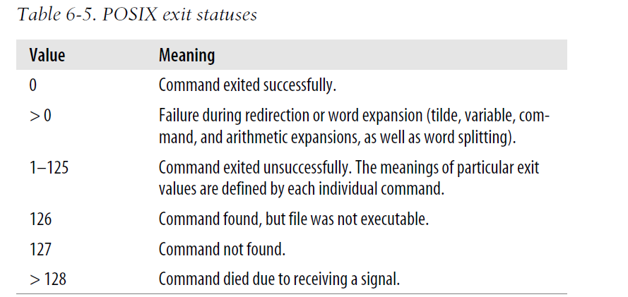

Slide 27
test command
Used to perform a variety of test in shell scripts, e.g., test file attributes, compares strings and numbers.
Provide no regular output, used exclusively for its exit status
Syntax:
test expression
[ expression ]
Note: space between [, ] and expression …

Slide 28
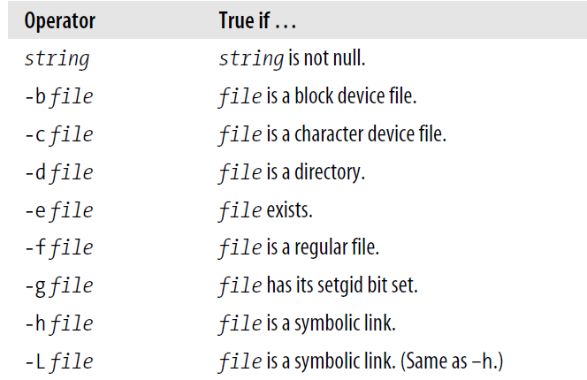

Slide 29
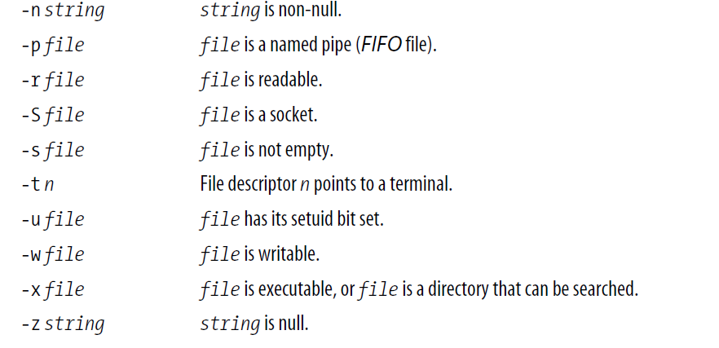

Slide 30
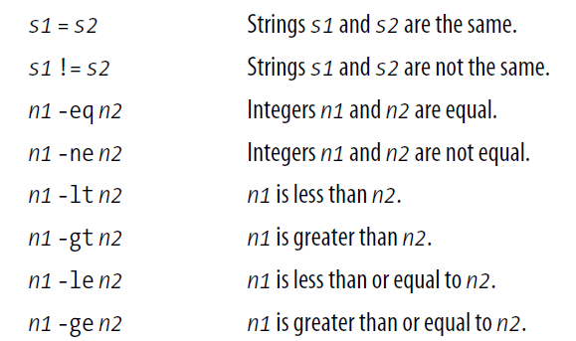
Numerical tests work on integers only.

Slide 31
Test status of file: file conditionals
File conditionals: unary expressions examining status of a file
if test –e /etc/.bashrc ## same as if [ -e /etc/.bashrc ]
## do something if /etc/.bashrc exists
then
## do something else if it doesn’t
fi
More testing
-d file: true if the file is a directory
-e file: true if the file exists
-f file: true if the file is a regular file.
-s file: true if the file has nonzero size

Slide 32
numerical comparison: example
echo -n "Enter your age: "
read age
if [ $age -lt 18 ]
then
echo "You need to be 18 or older to apply for account"
else
echo "Choose your preferred account name"
fi

Slide 33
Numeric Comparison: check arguments
Often in shell script, need to check # of command line arguments:
#! /bin/bash
## this script …
## check arguments …
if [ $# -lt 2 ] ## less than 2 command lines arguments are specified …
then
echo “usage: $0 file1 file2”
exit 1 ## 0 means succeed, otherwise failed
fi
…

Slide 34
string comparison
Exercise #1:
Write a script that read from standard input a string, and check if it’s the same as your secret password “secret”; if yes, print out “welcome!”; print out “Go away” if not.

Slide 35
Logical NOT, AND, and OR
if !grep pattern myfile > /dev/null ## Negation
then
# pattern not here
fi
if grep pattern1 file && grep pattern2 file
then
##contain both pattern
Fi
if grep pattern1 file || grep pattern2 file
then
## contain at least one pattern
fi

Slide 36
Roadmap
Shell variables
Shell Arithmetic
Control Structures
Test, condition, logic operations
Selection: if statements
Loop: while, until, for loops; break, continue
Case structure

Slide 37
Selection in shell
Implementing branch: change flow of control based on conditions
if condition
then
commands
fi
if condition
then
commands1
else
commands2
fi
if condition1
then
commands1
elif condition2
commands2
else
commands3
fi
case … in … esac
Can be repeated…

Slide 38
if control structure
Single-line Syntax
if TEST-COMMANDS; then CONSEQUENT-COMMANDS; fi
Multi-line Syntax
if TEST-COMMANDS
then
CONSEQUENT-COMMANDS
fi
Recall: command line terminates with NEWLINE, ;, &.

Slide 39
Testing in interactive shell
Write a script that read from standard input a string, and check if it’s the same as your secret password “secret”; if yes, print out “welcome!”; print out “Go away” if not.
test it out in interactive shell:
[zhang@storm ~]$ read string
secret
[zhang@storm ~]$ if [ $string == "secret" ]; then echo "Welcome"; else echo "Go away"; fi
Welcome

Slide 40
[zhang@storm ~]$ cat checkps
#!/bin/bash
echo -n "Enter your password: "
read password
if [ $password == "secret" ]
then
echo "Welcome!"
else
echo "Go away!"
fi
[zhang@storm ~]$ checkps
Enter your password: secret
Welcome!
[zhang@storm ~]$ checkps
Enter your password: guess
Go away!
[zhang@storm ~]$
Important note: When spanning multiple lines, do not need the ;

Slide 41
if … then … elif … then …else
if [[ "$op" == "+" ]]
then
result=$(($x + $y))
echo $x $op $y = $result
elif [[ "$op" == "-" ]]
then
result=$(($x - $y))
echo $x $op $y = $result
elif [[ "$op" == "*" ]]
then
result=$(($x * $y))
echo $x \* $y = $result
elif [[ "$op" == "/" ]]
then
result=$(($x / $y))
echo $x $op $y = $result
else
echo "Unknow operator $op"
fi

Slide 42
if… statements can be nested
#!/bin/bash
# This script will test if we're in a leap year or not.
year=`date +%Y`
if [ $[$year % 400] -eq 0 ]; then
echo "This is a leap year. February has 29 days."
elif [ $[$year % 4] -eq 0 ]; then
if [ $[$year % 100] -ne 0 ];
then echo "This is a leap year, February has 29 days."
else echo "This is not a leap year. February has 28 days."
fi
else echo "This is not a leap year. February has 28 days."
fi

Slide 43
Roadmap
Shell variables
Shell Arithmetic
Control Structures
Test, condition, logic operations
Selection: if statements
Loop: while, until, for loop; break, continue
case structure

Slide 44
Loop structure: while loop
Multi-line Syntax:
while condition
do
commands
done
Single-line Syntax (useful in interactive mode)
while condition; do commands; done
Note: condition and commands terminated with ;

Slide 45
while loop
declare –i i=1 ## an integer variable I
while [ $i -le 10 ]
do
echo "loop $i"
i=i+1 ## can use this since i is integer
done
If i is not declared as integer …
i=$(($i+1))
i=$[$i+1]

Slide 46
[zhang@storm ~]$ cat checkps
#!/bin/bash
echo -n "Enter your password: "
read password
if [ $password == "secret" ]
then
echo "Welcome!"
else
echo "Go away!"
fi
How to modify this to allow user to try until the password matches?

Slide 47
[zhang@storm ~]$ cat checkps
#!/bin/bash
while test $password != "secret" ## as long as password is not same as “secret”
do
echo -n "Enter your password: "
read password
done
echo "Welcome!”
What if we give the user at most 3 tries?
1. use a variable to keep track number of tries …
2. modify condition …

Slide 48
until loop
Tests for a condition, and keeps looping as long as that condition is false (opposite of while loop).
until condition
do command(s)...
done
e.g.:
$until [ $passwd == "secret" ] ; do echo -n "Try again: "; read passwd; done
Try again: guess
Try again: password
Try again: secret
$

Slide 49
Wait for a user to log in
# wait for a user to log in, check every 30 seconds
printf “Enter username:”
read user
until who | grep “$user” > /dev/null
do
sleep 30
done
Can you convert it to while loop?

Slide 50
Lazy evaluation
Recall binary operators &&, ||
&& has higher precendance than ||
Lazy evaluation:
command1 && command2 //if command1 fails, command2 will not be executed
command1 || command2 //if command1 succeeds, command2 will not be executed
E.g.,
test 5 -eq 5 && echo Yes || echo No
if [ test 5 –eq 5 ]; then echo yes; else echo No

Slide 51
Lazy evaluation(2)
Rewrite the following using lazy evaluation
if test –f /etc/resolv.conf
then
echo "File /etc/resolv.conf found."
else
echo "File /etc/resolv.conf not found.“
fi
test -f /etc/resolv.conf && echo "File /etc/resolv.conf found." || echo "File /etc/resolv.conf not found.“

Slide 52
For loops
For loop: iterates over a list of objects, executing loop body for each individual object in the list
for variable in a_list_of_objects
do
## do something on $variable
commands ..
done
e.g., for filename in lab1.cpp lab2.cpp lab3.cpp
do
indent $filename
done

Slide 53
For loop: example
Save student account name in a file, all.txt
for student in `cat all.txt`
do
echo “Hello, $student” > greeting_$student
grep $student student_rec.txt >>greeting_$student
write $student < greeting_$student
rm greeting_$student
done
How to avoid using temporary file, greeting_$student ?

Slide 54
Using for loop
Use for loop to print out 2’s power
Command seq: print out a sequence of number
#!/bin/bash
# print out 2’s powers
for a in `seq 1 10`
do
echo 2^$a=$((2**a))
done
Note: ** is the exponent operator

Slide 55
Roadmap
Shell variables
Shell Arithmetic
Control Structures
Test, condition, logic operations
Selection: if statements
Loop: while, until, for loop; break, continue
case structure

Slide 56
case construct: branching
case construct is analogus to switch in C/C++.
case "$variable" in shellpattern1 ) command... ;; shellpattern2)
command …
;; shell pattern n) command... ;; esac
Quoting variables is not mandatory
Each pattern can contain shell wildcard (*,?,[a-z]), ends with a )
Each condition block ends with ;;
If a condition tests true, then associated commands execute and the case block terminates.
entire case block ends with an esac

Slide 57
Calculator using case block
case "$op" in
"+" ) result=$(($x + $y))
echo $x $op $y = $result;;
"-" ) result=$(($x - $y))
echo $x $op $y = $result;;
"*" ) result=$(($x * $y))
echo $x \* $y = $result;;
"/" ) result=$(($x / $y))
echo $x $op $y = $result;;
* ) echo Unknow operator $op;;
esac

Slide 58
#!/bin/bash
OPT=$1 # option
FILE=$2 # filename
# test -e and -E command line args matching
case $OPT in
-e|-E)
echo "Editing $2 file..."
# make sure filename is passed else an error displayed
[ -z $FILE ] && { echo "File name missing"; exit 1; } || vi $FILE ;;
-c|-C)
echo "Displaying $2 file...“
[ -z $FILE ] && { echo "File name missing"; exit 1; } || cat $FILE ;;
-d|-D)
echo "Today is $(date)" ;;
*)
echo "Bad argument!"
echo "Usage: $0 -ecd filename"
echo " -e file : Edit file."
echo " -c file : Display file."
echo " -d : Display current date and time." ;;
esac
Lazy evaluation of && and ||
test if string is null

Slide 59
Case example
case $1 in
-f)
## case for –f option
;;
-d | --directory)
## -f or –directory option
;;
*)
echo $1: unknown option >&2
exit 1;
esac

Slide 60
Summary
Variables: environment, user-defined, parameter variable (i.e., positional parameter)
Default type is string
Use declare to declare a variable of other type
Variable asssignment: counter=1
set command can be used to set positional parameter
Arithmetic operations: +,-,*,/,**, %, …
x=$[$x+1] ## or x=$(($x+1))
x=x+1 ## if x is numerial type, declare –i x
60
Notes:
60

Slide 61
Summary: bash test
Any command/function/script that return 0 when succeed, non-zero if fail
if ! cp file1.txt file1.txt.bak
then
echo “failed to back up file1.txt”
fi
Test command: use test, or [ ], or [[ ]]
File testing: if [ -d $file ] ## if $file is a directory
String comparison: if [ $input = “secret” ]
Numerical comparison: if [ $i –eq 10 ]
Logic operations: [[ $age –le 50 && $age –gt 18 ]]
61
Notes:
61

Slide 62
Summary: control structure
They can be nested (just like programming languages)
They are commands, so, standard input/output redirection and pipeline can be applied to whole command
e.g.,
while read line
do
if [[ "$line" =~ "if" ]] ## matching, regular expression style
then
echo Found in $line
fi
done < testleap

